Slide 1
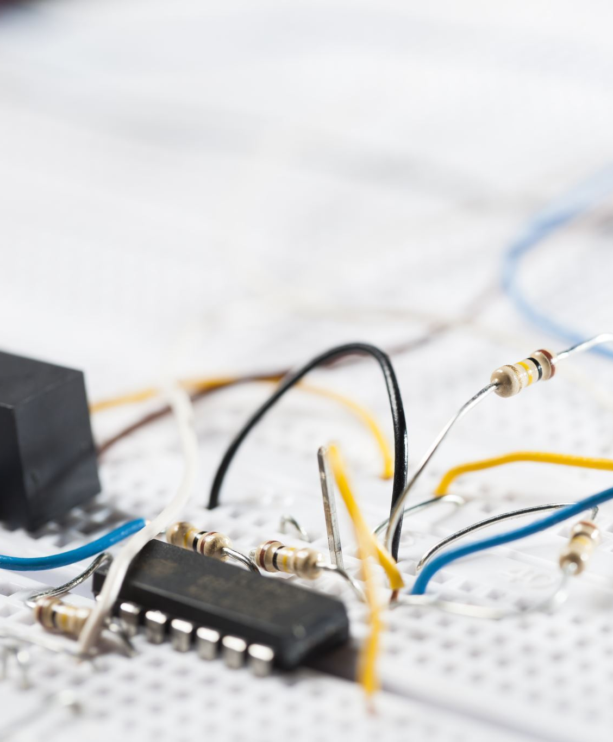
Electrical Engineering Music Box
Jih-Ching Chiu National Sun Yat-sen University Department of Electrical Engineering
MPD Laboratory

Slide 2
Circuit schematic diagram
Select song
Addr[7]
S[4..0]
Div[31..0]
Address
Generator
Memory
（Sheet music）
8bit*256
Memory
(Pitch)
32bit*32
Addr[7..0]
S[7..0]
reset
S[4:0]
Divider
(Sound
Frequency)
S[7..5]
Output
Addr[6..0]
S[4:0]
rst
m_clk
Output
Reset
end
Beat-
Divider
Table
Cp:change pulse
Count[5..0]
BDN
Divider
(Beat Clock)
BDN[5..0]
Asynchronous
Counter
Count
CMP(==)
Dff
Beat_clk
Simple Clock Domain Crossing Model
50MHz

Slide 3
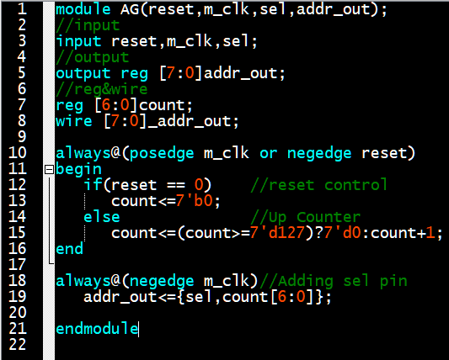
Adderess Generator
Select song
Addr[7]
Address
Generator
Addr[7..0]
Clock
Addr[6..0]

Slide 4
Beat frequency divider&Decoder
To represent most songs, we have divided them into 7 different note durations, including 1/32, 1/16, 1/8 notes, and so on. Therefore, in our design, we use 3 bits to represent these 7 different note durations.
Setting the shortest note, 1/32, to a value of 1, the 1/16 note to 2, and the 1/8 note to 4, and so on.
We've set the tempo of the music to 100 beats per minute (BPM). A 1/4 note is defined as one beat, one beat is equal to 6/10 seconds, which is equivalent to a frequency of 10/6 Hz.
The reference count of 1 for a 1/32 note is (1/8 * 6/10) seconds, which is equal to 80/6 Hz.

Slide 5
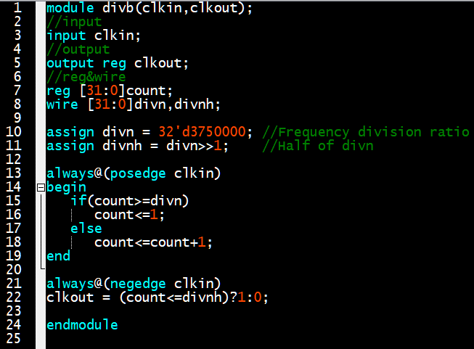
Beat frequency divider
Frequency divided by n means that one complete cycle is counted when reaching n.
So,when counting to n/2, the current state must be toggled.
Divider
(Beat)
Clock
Beat

Slide 6
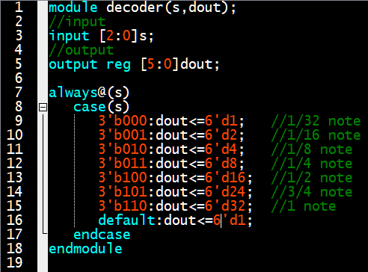
Decoder
note | Beat | Decoder Value
1/32 note | 1/8 beat | 1
1/16 note | 1/4 beat | 2
1/8 note | Half beat | 4
1/4 note | 1 beat | 8
1/2 note | 2 beat | 16
3/4 note | 3 beat | 24
1 note | 4 beat | 32
S[7..5]
Decoder
(Duration)
Durn

Slide 7
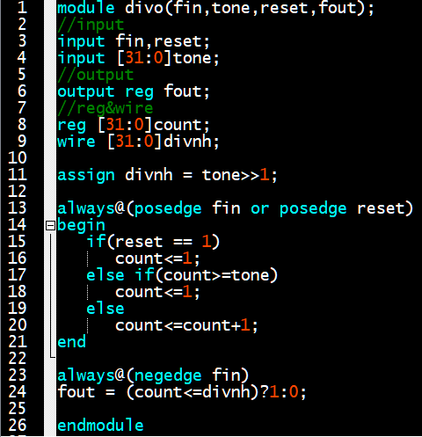
Audio frequency generation divider
The input tone is the division ratio retrieved from memory.
Div[31..0]
Divider
(Sound
Frequency)
Output
rst
Clock

Slide 8
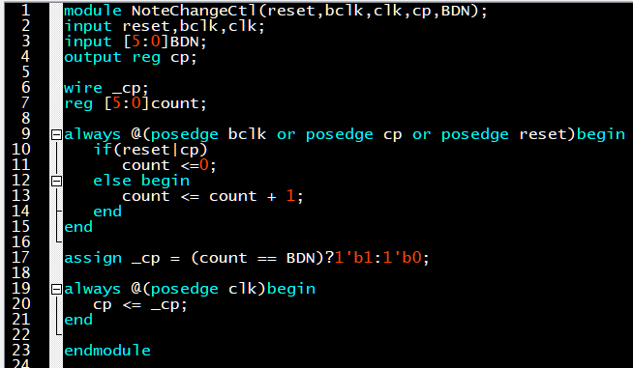
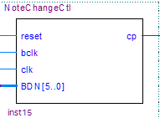
Simple Clock Domain Crossing Model

Slide 9
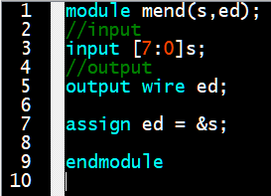
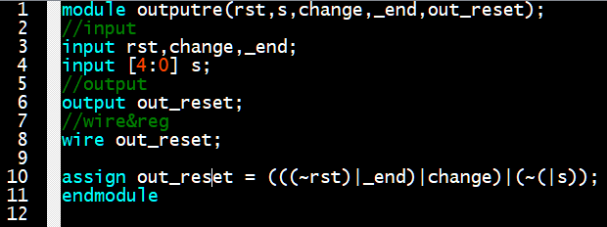
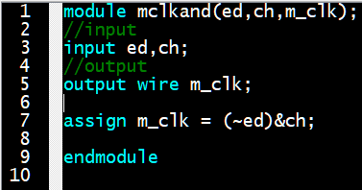
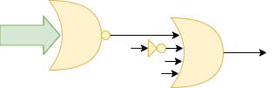
Output Reset & And Data
S[4...0]
reset
Out_reset
end
Change
S[7..0]
change
end
m_clk
end

Slide 10
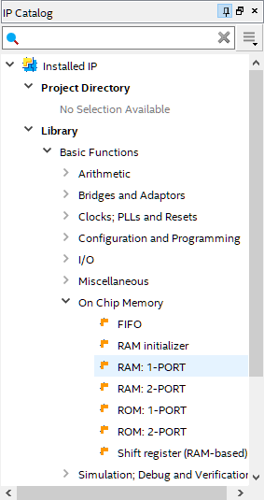
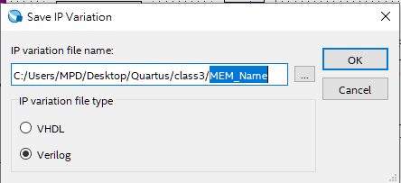
Memory creation
Step4
Step2:Enter name
Step3
step1

Slide 11
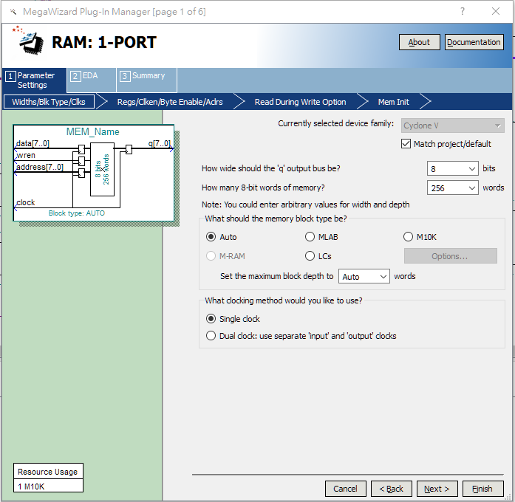
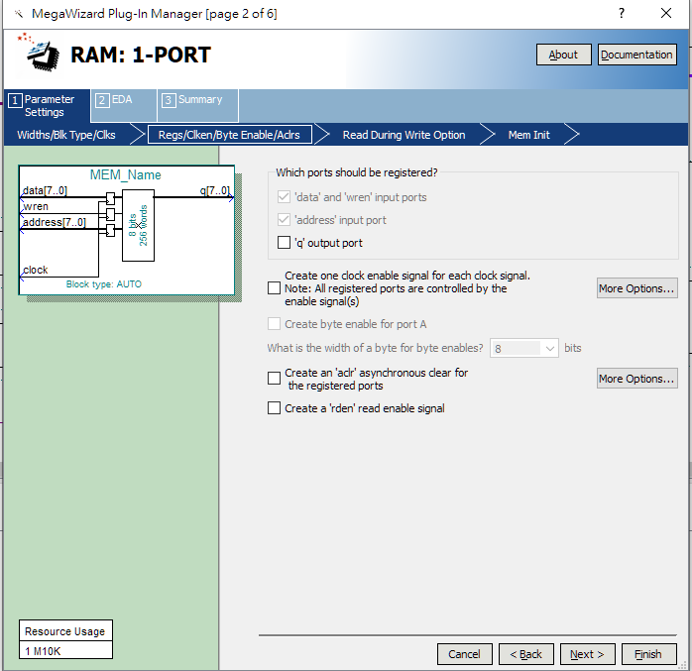
Memory creation
Step7
Step5
Step8
Step6

Slide 12
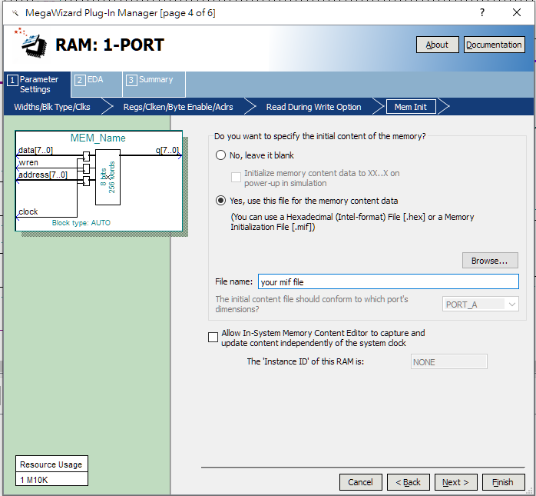
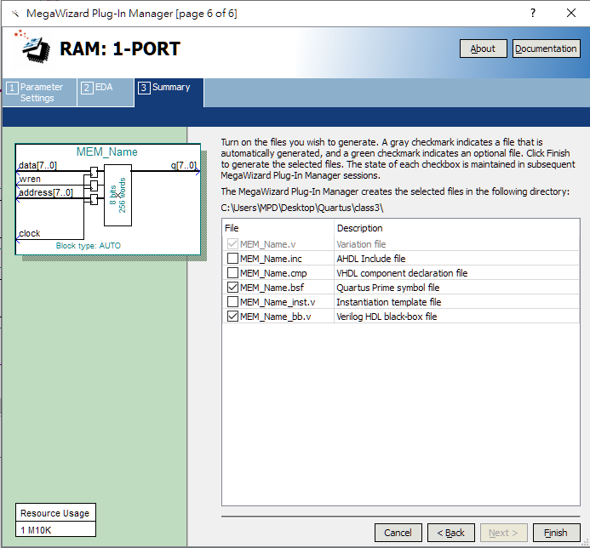
Memory creation
Step9
Step12
Step10
Please move your .mif file to the project folder. There should be no Chinese characters in the file path.
Step13
Step11
Step14

Slide 13
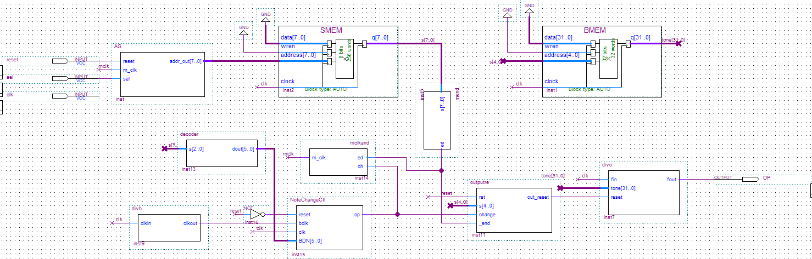
Wiring

